Slide 1
Multithreading in Java
Multithreading in Java is a feature that enables a program to run multiple threads simultaneously, allowing tasks to execute in parallel and utilize the CPU more efficiently.
A thread is a lightweight, independent unit of execution inside a program (process).
A process can have multiple threads.
Each thread runs independently but shares the same memory.

Slide 2
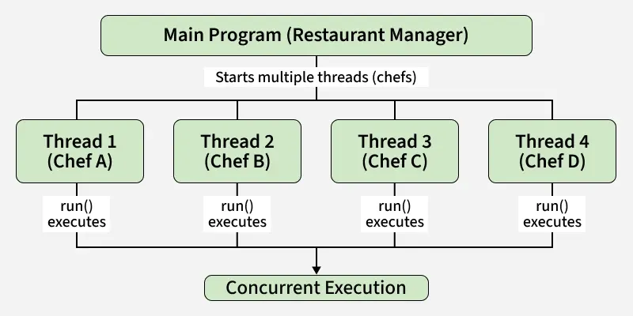
Example: Imagine a restaurant kitchen
Multiple chefs (threads) are preparing different dishes at the same time.
This speeds up service and utilizes all available resources (CPU).

Slide 3
Creating Threads in Java
In Java, there are several ways to create and run threads.
Each approach has its own use cases, and choosing the right one depends on how your application is structured.
Extending the Thread class
Implementing the Runnable interface
Using lambda expressions (Java 8 and later)

Slide 4
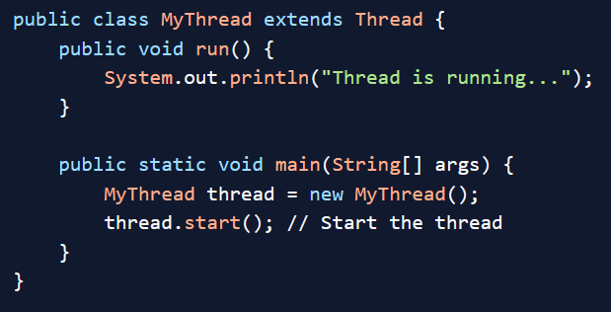
1. Extending the Thread Class
One of the simplest ways to create a thread in Java is by extending the built-in Thread class and overriding its run() method.
This method contains the code that should run in the new thread.

Slide 5
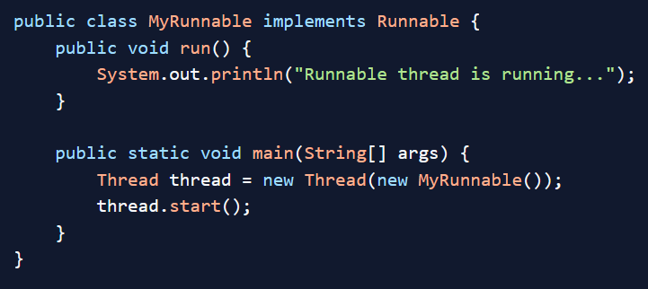
2. Implementing the Runnable Interface
A more flexible way to create threads is to implement the Runnable interface.
This separates the task from the thread itself, which is useful when you want your class to extend another class.

Slide 6
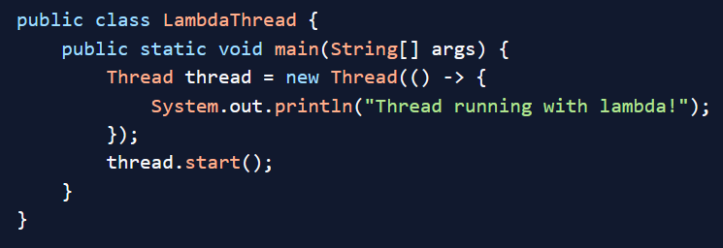
3. Using Lambda Expressions (Java 8+)
If you’re using Java 8 or later, you can simplify thread creation using lambda expressions.
This is ideal for short, one-off tasks where you don’t want to write a full class.

Slide 7
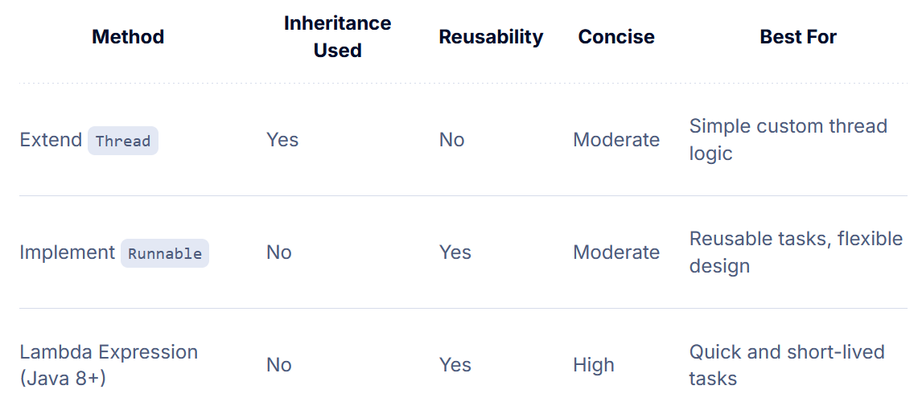
Thread Creation Comparison

Slide 8
Why Use Multithreading in Java?
Multithreading offers several key advantages:
Improved Performance:
Threads can run in parallel on multi-core processors, making efficient use of system resources.
Responsive Applications:
Multithreading helps keep user interfaces responsive by offloading long-running tasks to background threads.
Resource Sharing:
Threads share memory and resources, enabling faster context switching and inter-thread communication.
Asynchronous Processing:
Tasks like file I/O, network requests, or database operations can run independently of the main application flow.

Slide 9
Real-World Use Cases of Multithreading
Multithreading is widely used in modern Java applications across many domains:
Web Servers:
Handle multiple client requests concurrently.
GUI Applications:
Keep the UI responsive during background operations.
Games:
Manage rendering, physics calculations, and input handling in parallel.
Real-Time Systems:
Perform time-sensitive tasks simultaneously.
Data Processing Pipelines:
Parallelize large-scale data computations and I/O operations.

Slide 10
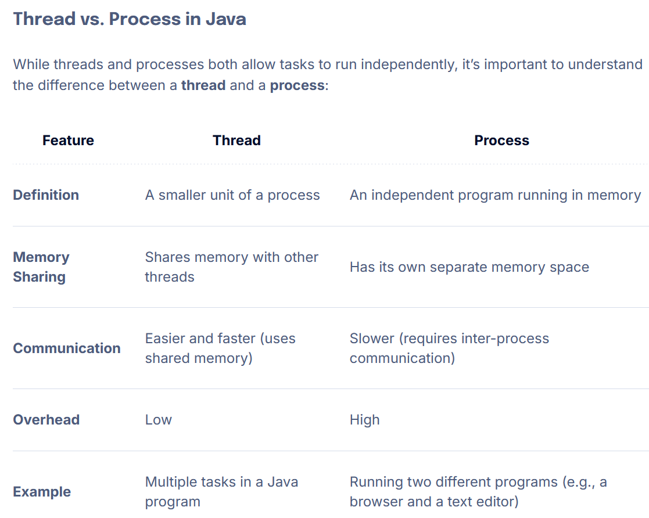

Slide 11
